Slide 1

Tachyon Backend Role - Task 2
Rahul T
Backend Developer Role
Topics Implemented: 1, 2 & 4
Full Stack Task Management with Real-time Chat
Notes:
"Hello everyone. My name is Rahul, and this is my presentation for the Tachyon Systems' Backend Developer role, Task 2.
For this application walkthrough, I've implemented the offline exercises for Topic 1 (REST API with CRUD), Topic 2 (JWT Authentication), and Topic 4 (WebSocket Chat). I've combined all three of these requirements into a single, comprehensive project: a full-stack task management application called 'TaskFlow', which also includes a real-time collaboration chat feature."

Slide 2
Project Overview
Complete Full-Stack Task Management Application
Built with Node.js + Express backend
Secure JWT-based authentication system
Real-time WebSocket chat integration
RESTful API with full CRUD operations
User-specific task isolation and management
Modern React frontend with responsive design
SQLite database with Sequelize ORM
Notes:
"To give you a high-level overview, this is a complete full-stack application. The backend is built using Node.js and Express , and it provides a full RESTful API with all CRUD operations for managing tasks.
A key requirement was security, so I've implemented a robust, secure JWT-based authentication system. This is critical because it ensures that all task management is isolated to the specific user.
On the frontend, it uses a modern, responsive React build. For the database, I chose SQLite with the Sequelize ORM, which makes managing the models and queries clean and efficient. And finally, to satisfy Topic 4, I've integrated a real-time chat feature using WebSockets."

Slide 3
Topics Implemented
Topic 1: REST API with CRUD Operations
Complete RESTful API architecture
Create, Read, Update, Delete operations for tasks
User-specific resource management
Express.js routing and middleware
HTTP status codes and error handling
Topic 2: JWT Authentication
Secure token-based authentication system
User registration and login endpoints
Password hashing with bcrypt (10 salt rounds)
Protected routes with authentication middleware
Token expiry management (7-day validity)
Notes:
"Let's dive into the first topic I implemented:
1. Topic 1, the REST API with CRUD operations.
I designed a complete RESTful API architecture that handles the core logic of the application. This includes all the standard Create, Read, Update, and Delete operations for tasks.
A critical part of this was ensuring user-specific resource management; this means users can only see and manage their own tasks. This is all built on Express.js, using its routing and middleware capabilities to structure the API logically. I also paid close attention to proper API design, including using correct HTTP status codes for responses and implementing thorough error handling.”
—————————————————————————-
Next is Topic 2, which was JWT-based authentication. This is the security core of the application. I built a secure, token-based system with endpoints for both user registration and login.
When a user registers, their password isn't stored in plain text; it's securely hashed using bcrypt. Once a user logs in, the server generates a JSON Web Token, which I've set to have a 7-day validity.
This token is then required for all protected routes, like creating or viewing tasks. I implemented custom authentication middleware to check for this token, validate it, and protect those endpoints from unauthorized access.

Slide 4
Topics Implemented (Continued)
Topic 4: Real-time WebSocket Chat
Socket.io integration for real-time communication
Room-based chat functionality
Instant message delivery and updates
Connected client management
Event-driven message broadcasting
CORS-enabled WebSocket server
Integration with React frontend
Notes:
Finally, I implemented Topic 4: a real-time chat server using WebSockets.
For this, I used Socket.io, which integrates really well with the existing Node.js and Express server. This isn't just a simple "shout-box"; I implemented room-based chat functionality, so users can join specific rooms for collaboration.
The communication is event-driven , allowing for instant message delivery and updates. The server manages the connected clients and, of course, is set up with the proper CORS configuration to allow the React frontend to connect to it."

Slide 5
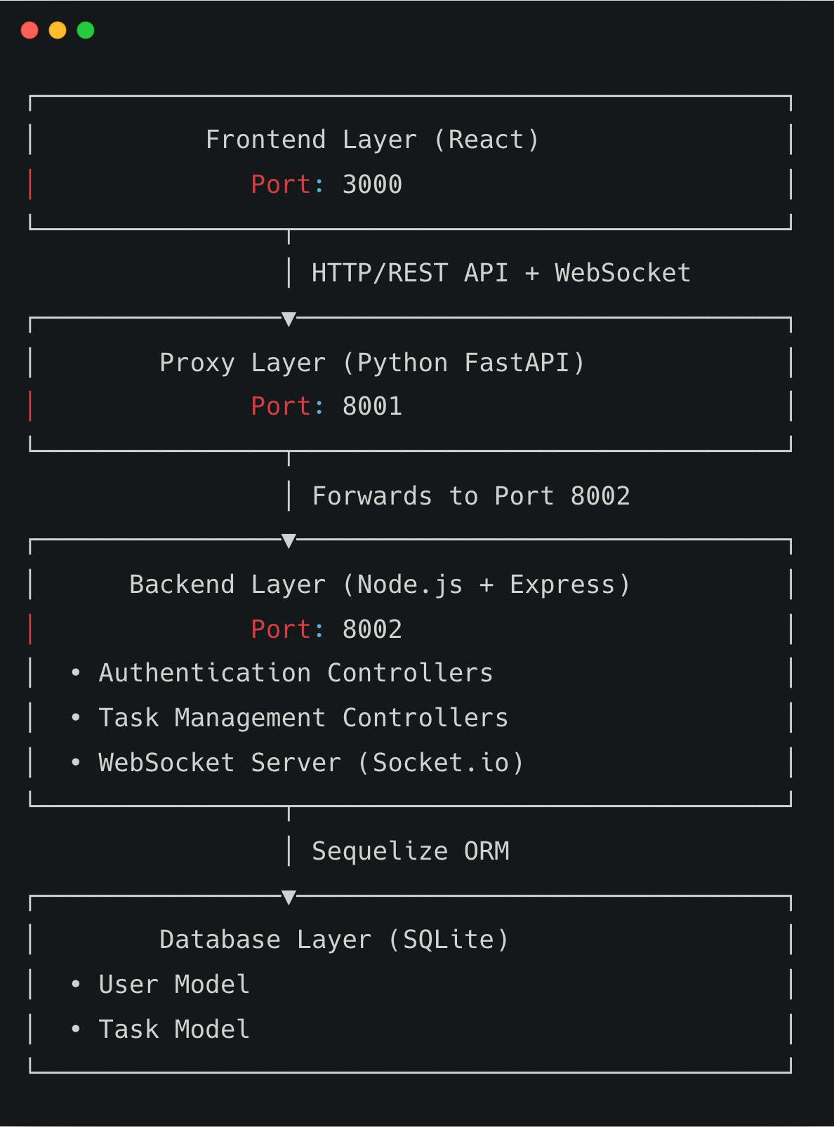
System Architecture
Clean separation of concerns with modular design
Stateless API architecture for scalability
Notes:
This slide shows the system architecture I designed for the application. It's built with a clean separation of concerns.
At the top, we have the Frontend Layer, which is the React application running on port 3000. It communicates via HTTP/REST API calls and WebSocket connections.
I then added a Proxy Layer using Python's FastAPI on port 8001. This layer forwards all traffic to the main backend.
The core of the project is the Backend Layer on port 8002, built with Node.js and Express. This is where the controllers for authentication and task management live, as well as the Socket.io WebSocket server.
This backend layer communicates with the Database Layer using the Sequelize ORM. The database itself is SQLite, which holds the User and Task models. This entire design is a stateless API architecture, which is great for scalability.

Slide 6
Technology Stack
Backend Technologies
Node.js - JavaScript runtime environment
Express.js - Web application framework
Socket.io - Real-time bidirectional communication
Sequelize ORM - Database object-relational mapping
SQLite - Embedded relational database
JWT (jsonwebtoken) - Secure authentication tokens
bcrypt - Password hashing algorithm
FastAPI (Python) - High-performance proxy layer
Frontend Technologies
React - UI component library
React Router - Client-side routing
Axios - HTTP client for API requests
Vite - Fast build tool and dev server
Notes:
Here’s a quick look at the specific technologies used.
For the backend , the main stack is Node.js with the Express.js framework. For real-time chat, I used Socket.io. The database is SQLite , managed with the Sequelize ORM. For authentication, I used jsonwebtoken and bcrypt. And as I mentioned, I used FastAPI for the proxy layer.
On the frontend , it’s a standard, modern stack: React for the UI , React Router for navigation , Axios for making the API requests , and Vite as the build tool."

Slide 7
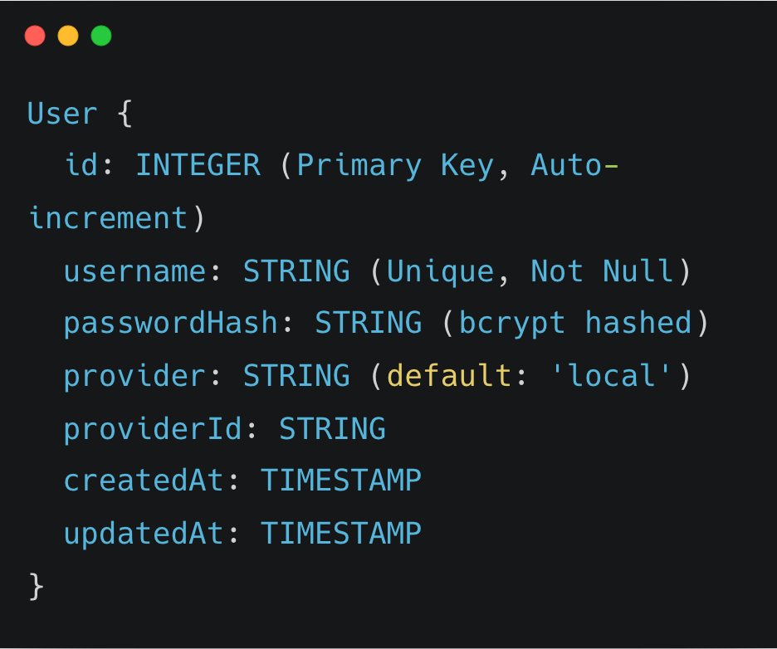
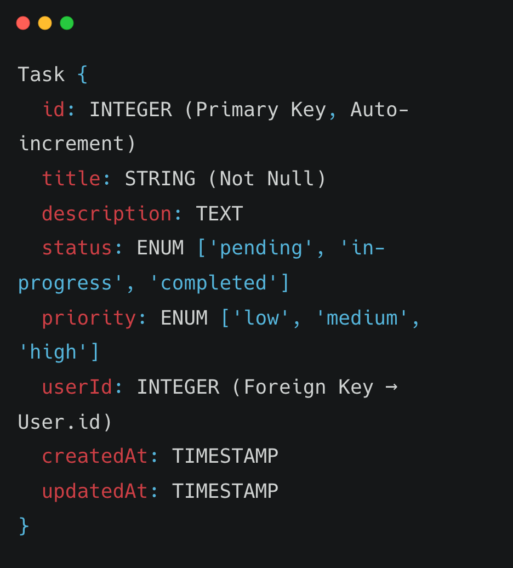
Database Schema
User Model
Task Model
Caption
Caption
Notes:
The database schema is straightforward but effective. I have two main models: the User model and the Task model.
The User model stores the ID, a unique username, and the bcrypt-hashed password.
The Task model stores all the task details, like title, description, and its status—such as 'pending' or 'completed'.
The key field here is the userId in the Task model. This is a foreign key that links every task to a user. This establishes the one-to-many relationship and is what allows us to enforce user-specific data isolation."

Slide 8
API Endpoints
Authentication APIs
POST /api/auth/register - User registration with password hashing
POST /api/auth/login - User login with JWT token generation
Task Management APIs (Protected)
GET /api/tasks - Fetch all tasks for authenticated user
POST /api/tasks - Create new task
PUT /api/tasks/:id - Update existing task
DELETE /api/tasks/:id - Delete task
Health Check
GET /health - Server health status check
Notes:
"Here are the main API endpoints I created. They are grouped into two categories, plus a health check.
First, the Authentication APIs, which are public. We have POST /api/auth/register for creating a new user and POST /api/auth/login to sign in and receive a JWT token.
Second, the Task Management APIs. These are all protected and require the JWT token. This includes GET /api/tasks to fetch all of a user's tasks , POST /api/tasks to create a new one , and PUT and DELETE routes for updating or deleting a specific task by its ID.
I also included a simple GET /health check endpoint."

Slide 9
JWT Authentication Flow
1. User Registration/Login
└── Client sends username and password
2. Server Validation
└── Password hashed with bcrypt and compared
3. Token Generation
└── Server generates JWT with user ID and username (7-day expiry)
4. Client Storage
└── Token stored in browser localStorage
5. Authenticated Requests
└── Client includes token in Authorization header (Bearer token)
6. Token Verification
└── Server middleware validates JWT signature and expiry
✅ Stateless authentication - No session storage required
Notes:
"This slide details the complete JWT authentication flow, step-by-step.
First, the user registers or logs in by sending their credentials.
The server validates these, hashing the password with bcrypt to compare it.
If successful, the server generates a new JWT with the user's ID and sets it to expire in 7 days.
This token is sent back to the client, which then stores it in browser localStorage.
From that point on, for every authenticated request, the client includes that token in the 'Authorization' header as a Bearer token.
Finally, my server-side middleware intercepts this request, verifies the token's signature, and only then allows the request to proceed.
This is a fully stateless authentication system, which is highly scalable as it doesn't require any session storage on the server."

Slide 10
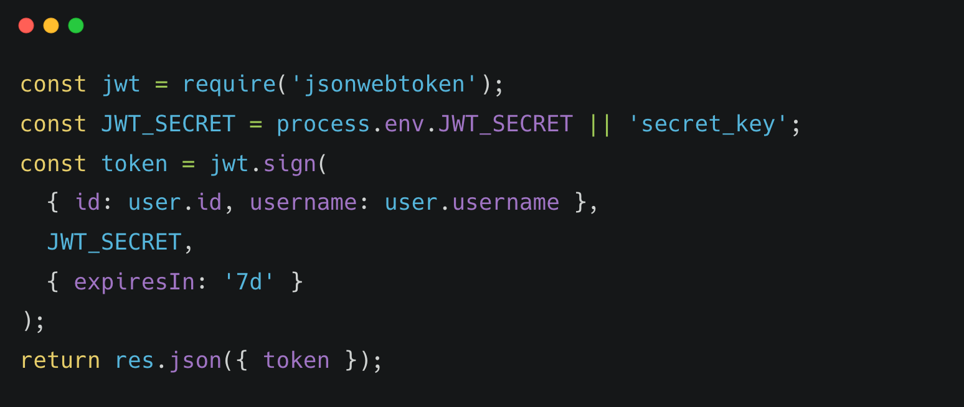
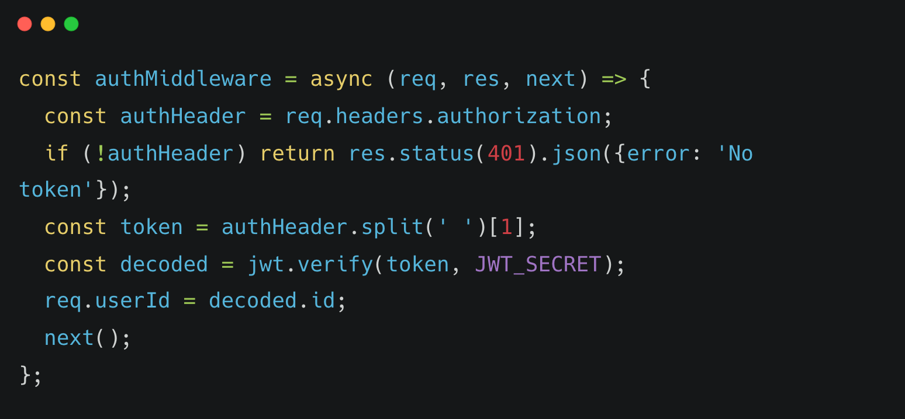
JWT Implementation Code
Token Generation (Login/Register)
Caption
Token Verification Middleware
Caption
Notes:
"Here are the two key code snippets that power the JWT flow. I'll show this in more detail in the live code walkthrough, but this is the core of it.
On the left is the token generation. After a user is validated, we use the jwt.sign method, passing in a payload with the user's ID, our secret key, and the 7-day expiry.
On the right is the verification middleware. This function checks the 'authorization' header, splits out the token, and then uses jwt.verify to decode it. If it's valid, it attaches the user's ID to the request object and calls 'next()'. If not, it returns a 401 'No token' or 'Invalid token' error."

Slide 11
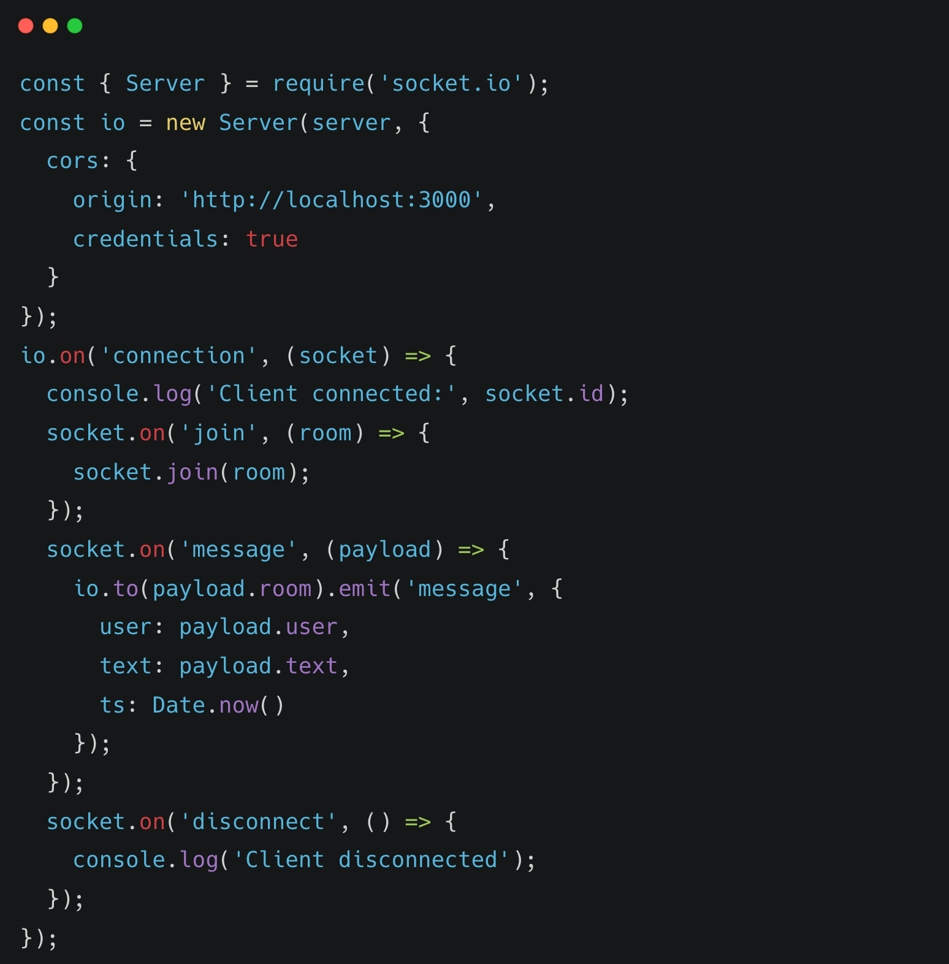
WebSocket (Socket.io) Implementation
Server Setup
Notes:
"Similarly, here is the core code for the WebSocket implementation. This is the server-side setup using Socket.io.
First, I initialize a new Socket.io Server, passing in the Express server and a CORS configuration to allow my React app on 'localhost:3000' to connect.
The main logic is inside the io.on('connection') event. When a client connects, I've set up three main event listeners: a 'join' event, which allows a user to join a specific room; a 'message' event, which takes the payload and then emits that message only to other clients in that same room; and a 'disconnect' event. This event-driven model is what makes the real-time chat possible."

Slide 12
Key Features Implemented
1. Secure Authentication
└── JWT tokens with bcrypt password hashing
2. Complete Task CRUD
└── Create, read, update, delete with full validation
3. User Task Isolation
└── Users can only access their own tasks
4. Real-time Chat
└── WebSocket-powered instant messaging with rooms
5. Modern Responsive UI
└── Clean React interface with intuitive navigation
6. Performance Optimized
└── Efficient queries and indexed database
7. Security Best Practices
└── Input validation, error handling, CORS configuration
Notes:
"So, to summarize the key features I've successfully implemented:
We have secure authentication using JWT and bcrypt.
We have the complete Task CRUD functionality.
A critical feature is user task isolation, ensuring users only access their own data.
We have the real-time, room-based chat powered by WebSockets.
This is all served to a modern, responsive React UI.
And throughout development, I focused on performance and security best practices, like input validation and CORS configuration."

Slide 13
Security Implementation
Password Hashing: bcrypt with 10 salt rounds
JWT Tokens: Signed with secret key, 7-day expiry
Protected Routes: Authentication middleware on all task APIs
User Data Isolation: Database queries filtered by userId
CORS Configuration: Controlled cross-origin access
Input Validation: Request body validation and sanitization
Error Handling: Safe error messages without sensitive data
SQL Injection Prevention: Sequelize ORM parameterized queries
Token Verification: Middleware validates every protected request
Notes:
I wanted to dedicate one slide to the security implementation, as it's a critical part of any backend system.
As mentioned, passwords are hashed with bcrypt.
All sensitive task routes are protected by JWT token middleware.
Data isolation is enforced at the database level, where all queries are filtered by the authenticated user's ID.
I have a strict CORS policy configured to only allow the frontend.
I'm also using the Sequelize ORM, which inherently provides protection against SQL injection by using parameterized queries.
Finally, I've implemented input validation and careful error handling to ensure no sensitive data is ever leaked in an error message."

Slide 14
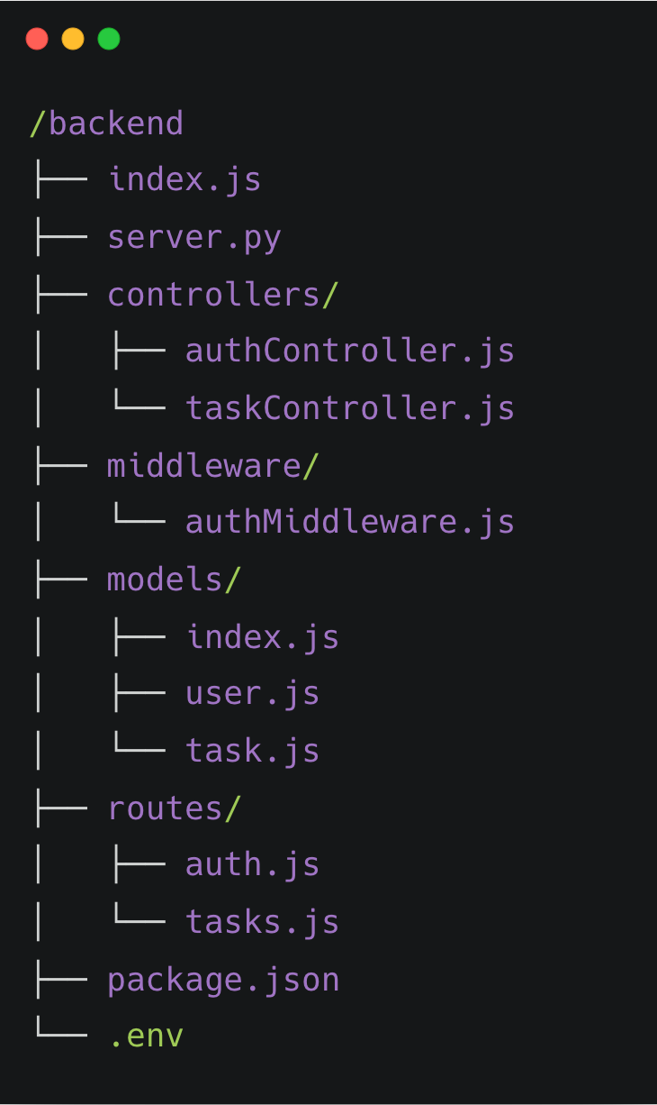
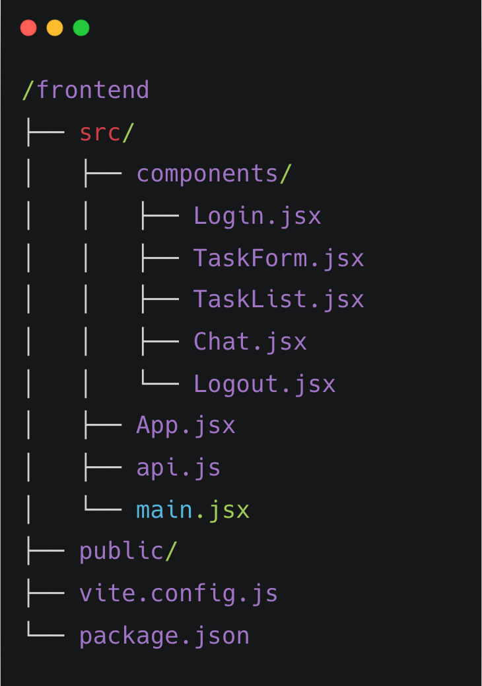
Project Structure
Backend Directory Structure
Frontend Directory Structure
Caption
Caption
Notes:
"This slide shows the project's directory structure, which I've kept clean and modular. The project is split into a /backend folder and a /frontend folder.
Inside the backend, you can see a clear separation. I have a /controllers directory for the business logic, /middleware for the auth check, /models for the database schema, and /routes to define the API endpoints. This separation of concerns makes the code much easier to maintain.
The frontend structure is a standard Vite-React setup, with a /components directory for all the UI pieces like the TaskList, Chat, and Login forms

Slide 15
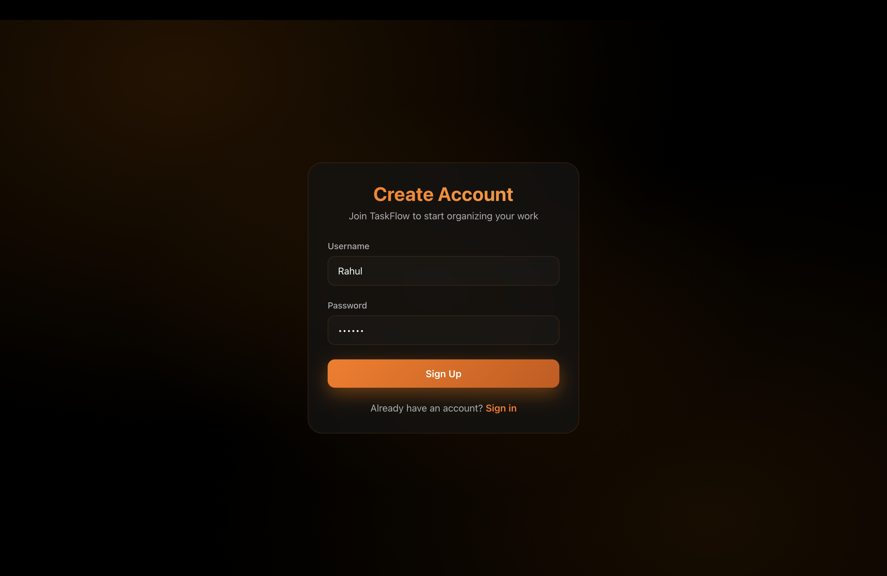
Project Screenshots
User registration form with secure input validation and bcrypt password hashing.
Notes:
the following slides are screenshots of the application, but rather than just walking you through static images, I'd like to switch over now and show you the 'TaskFlow' application running live.

Slide 16
Project Screenshots
Login interface for JWT-based authentication, ensuring secure user access.

Slide 17
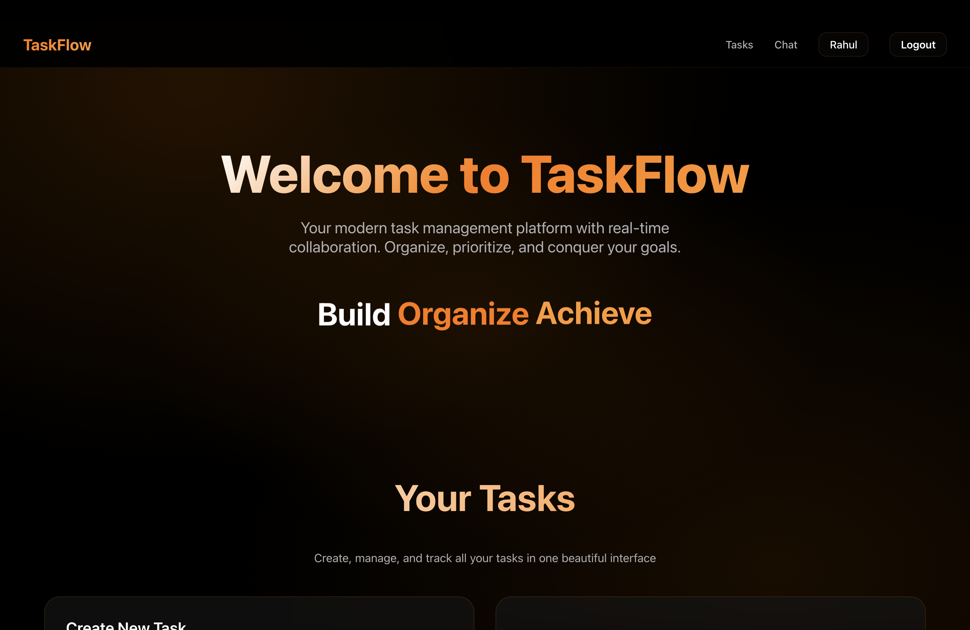
Project Screenshots
Welcome to TaskFlow: A clean and responsive React-based homepage for seamless task management.

Slide 18
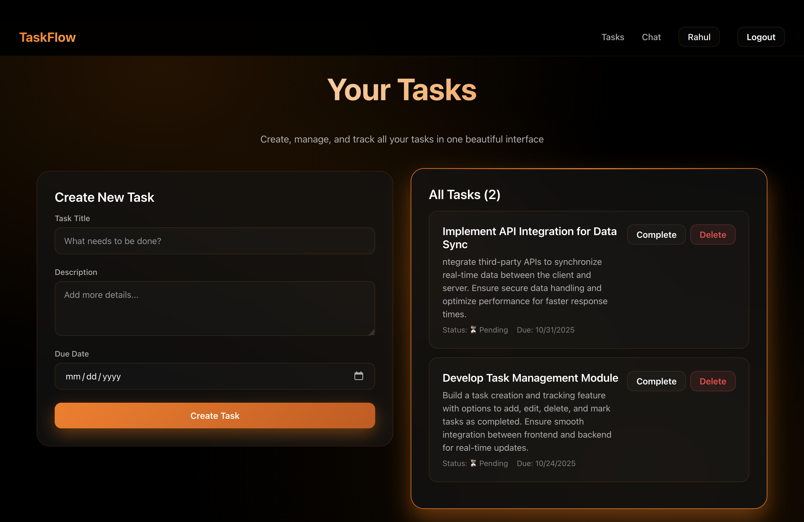
Project Screenshots
User-specific task dashboard with CRUD functionality, built with React and RESTful API integration.

Slide 19
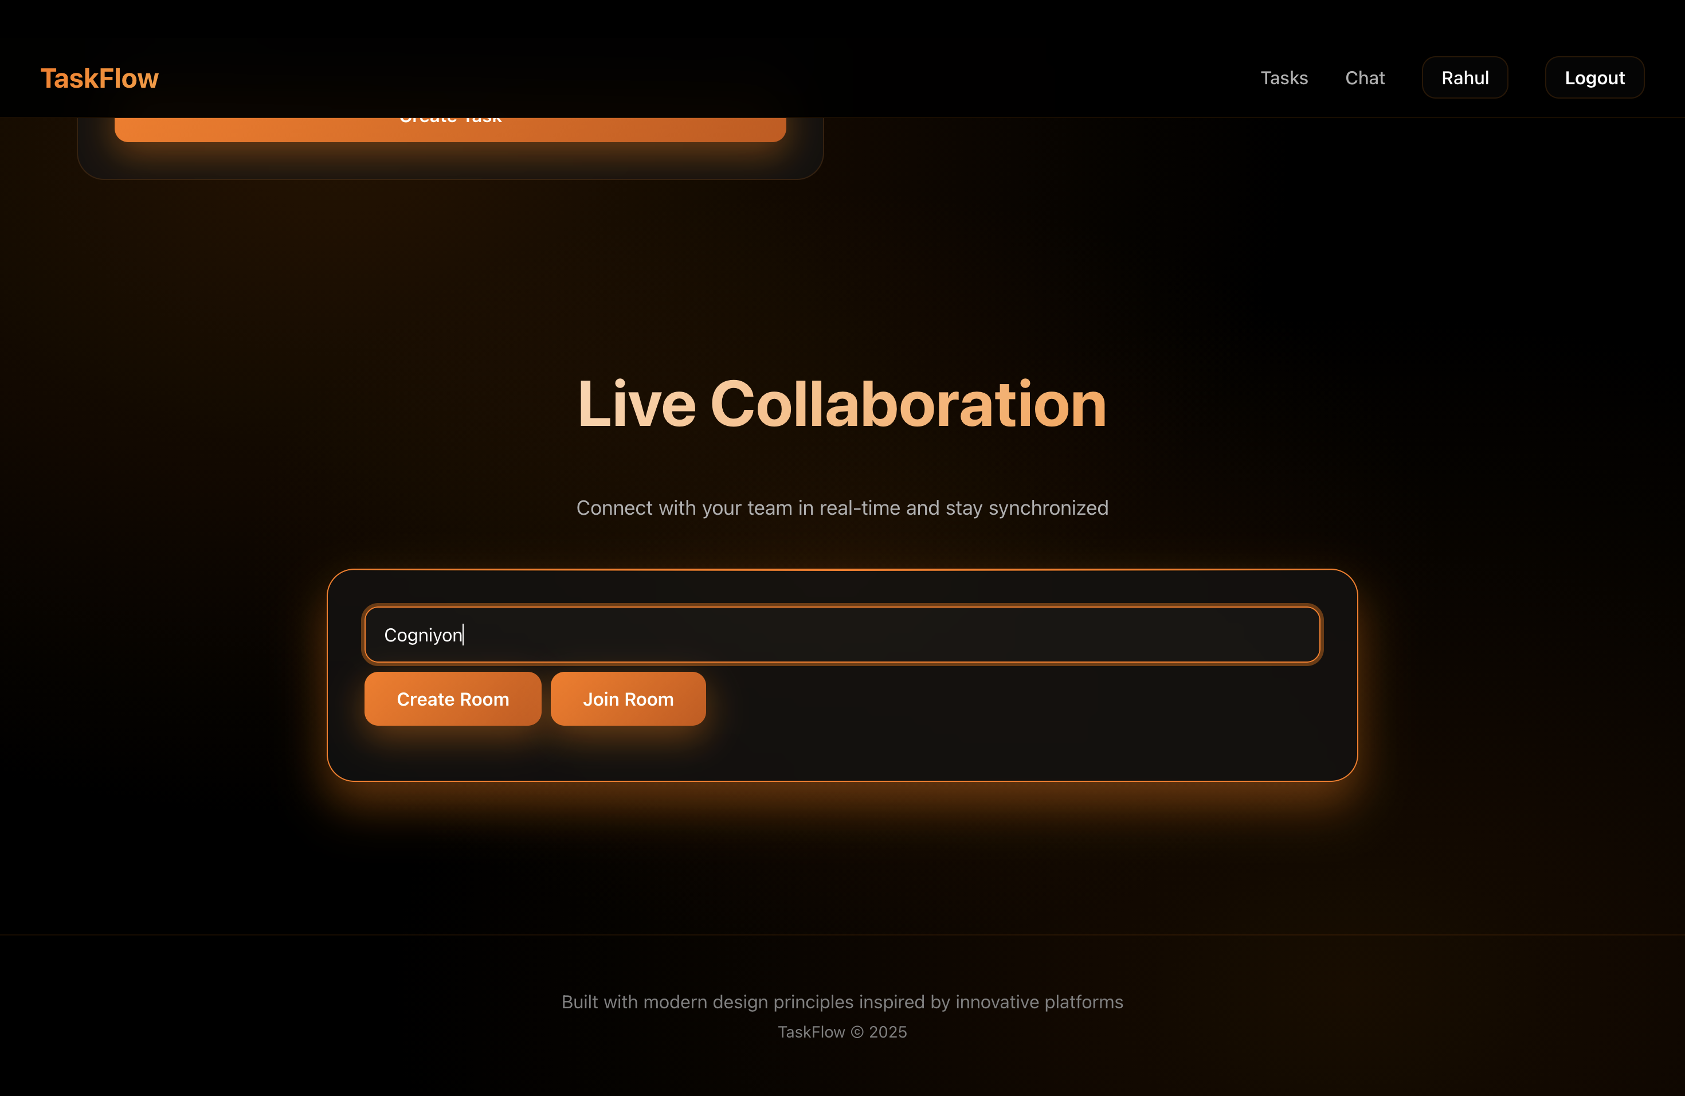
Project Screenshots
Socket.io-powered chat interface enabling instant messaging with room-based functionality.

Slide 20
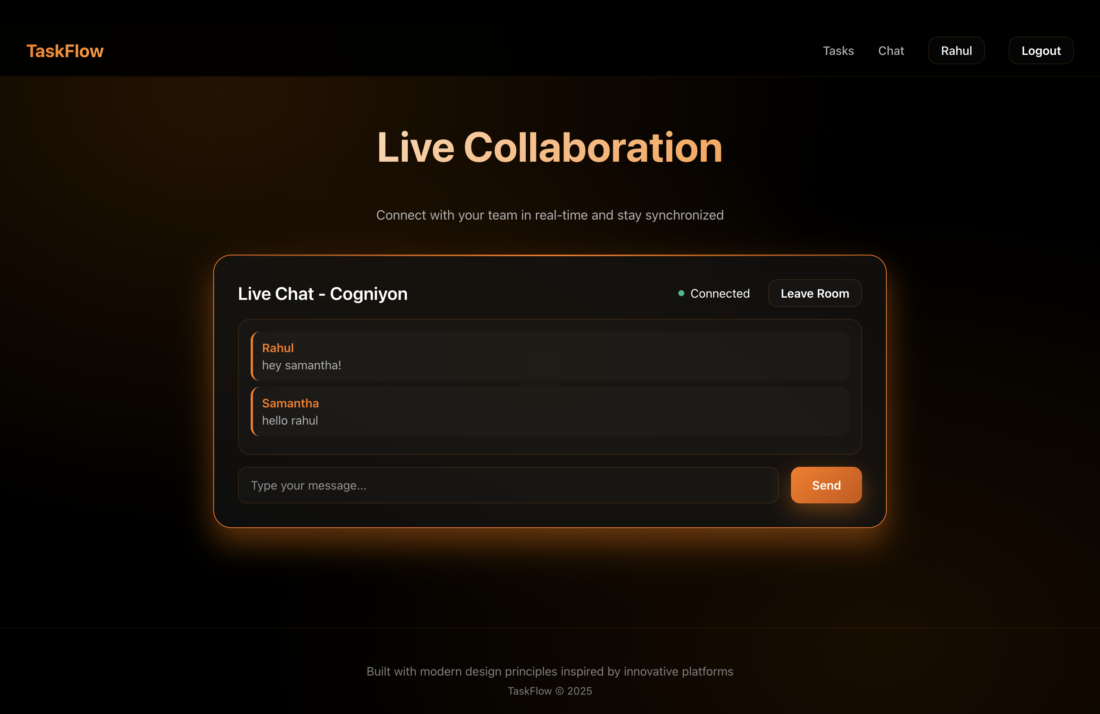
Project Screenshots
Caption

Slide 21
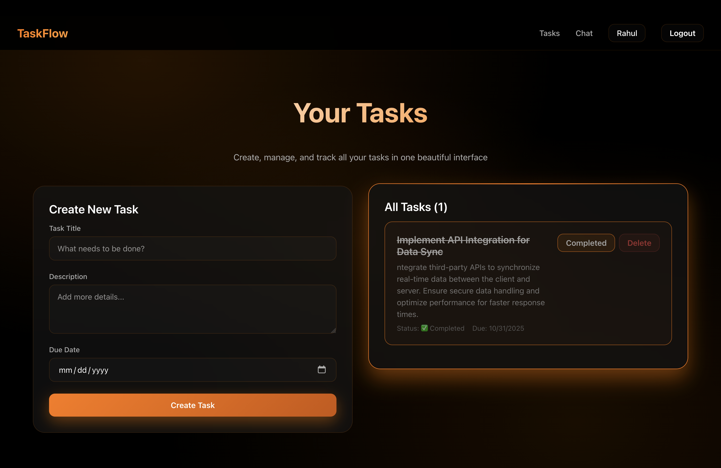
Project Screenshots
Displays user-specific tasks with options to edit or delete, ensuring data isolation.

Slide 22
Testing & Validation Results
Backend API Testing (via curl/Postman)
User registration with password hashing
User login with JWT token generation
Task creation with userId association
Task retrieval (user-specific filtering)
Task update with ownership validation
Task deletion with authorization check
middleware blocking unauthorized access
Frontend Integration Testing
User signup flow with validation
User login with token storage
Task isolation between different users
Real-time chat with multiple clients
WebSocket room-based messaging
Notes:
As you saw in the live demonstration, I've validated all the key functionality.
On the backend , user registration, login, and all task CRUD operations are working correctly. Most importantly, the user-specific filtering and the authentication middleware correctly block unauthorized access.
On the frontend , the signup and login flows work, the token is stored properly , and task isolation between different users is confirmed. And as we saw, the real-time chat works perfectly with multiple clients in different rooms."

Slide 23
Challenges & Solutions
Challenge 1: User Task Isolation
Problem: Tasks visible across all users
Solution: Added userId filtering in all task queries
Challenge 2: Real-time Communication
Problem: Implementing bidirectional messaging
Solution: Socket.io with room-based event system
Challenge 3: API Architecture
Problem: Managing complex routing
Solution: FastAPI proxy + Express modular routing
Notes:
"During development, I encountered a few challenges I'd like to highlight.
The first was ensuring proper user task isolation. Initially, the API was just returning all tasks. The solution was to use the userId from the decoded JWT token and apply it as a 'where' clause in all my Sequelize queries, so the database only returns tasks matching that user.
The second challenge was implementing the bidirectional messaging. The solution was to use Socket.io and design an event-based system with a 'join' event, and then broadcast 'message' events only to that specific room.
Finally, as the API grew, managing the routing became complex. My solution was to implement a FastAPI proxy in front of the Express server. This allows me to cleanly separate and manage the routes and gives me a flexible architecture for future expansion."

Slide 24
Future Enhancements & Scope
OAuth2 Integration (Google, GitHub, Microsoft)
Task Analytics Dashboard with charts
Task categories, tags, and labels
Task sharing and team collaboration
File attachments for tasks
Email notifications for task updates
Notes:
This project has a solid foundation, and there are many features I'd love to add in the future. My top priorities would be implementing OAuth2 integration for Google or GitHub logins , building a task analytics dashboard , and adding team collaboration features like sharing tasks and file attachments."

Slide 25
Thank You! 🙏
Tachyon - Task 2
Rahul T
Backend Developer Role
Topics Completed: 1, 2 & 4 ✅
Gtihub Link: https://github.com/therahul-yo/tachyon-backend-task-2.git
Notes:
That concludes my application walkthrough for the Backend Developer role, where I've demonstrated my implementation of topics 1, 2, and 4. I've built a secure, real-time, full-stack application that meets all the core requirements.
Thank you very much for your time and for this opportunity. I'd be happy to answer any questions you may have."

